Slide 1




AI Research
F24-6 Sprint Demo
`
© Conestoga College. All rights reserved.

Slide 2

Team
Copilot Studio | Tech
Arsh Chauhan | Hamna Ashraf
Paras Rupani | Wei-Hsiang Chen
 | Jongeon Lee

Slide 3

Sprint Goal
Optimizing the model.
Limiting the model’s responses to the data source.
Improving responses focusing on Level 2.
Improving incorrectly linked sources for user queries.
Setting up environment on another laptop for demo
Optimizing the code ensuring successful execution of the application.
Researching about implementations using React

Slide 4
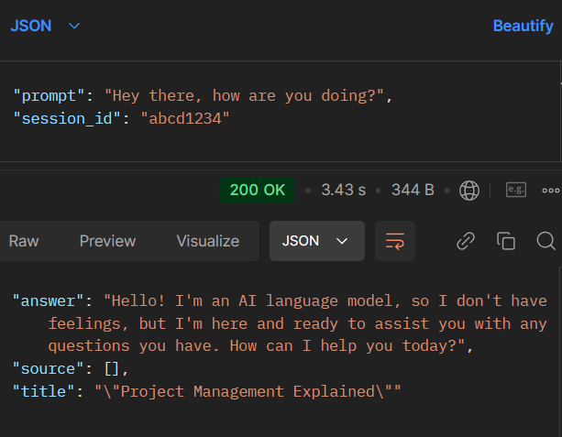
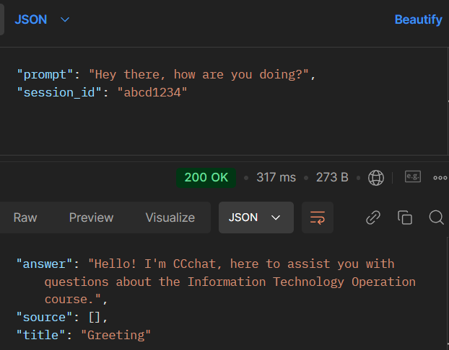
Demo
Greeting
Previous Response
Current Response

Slide 5
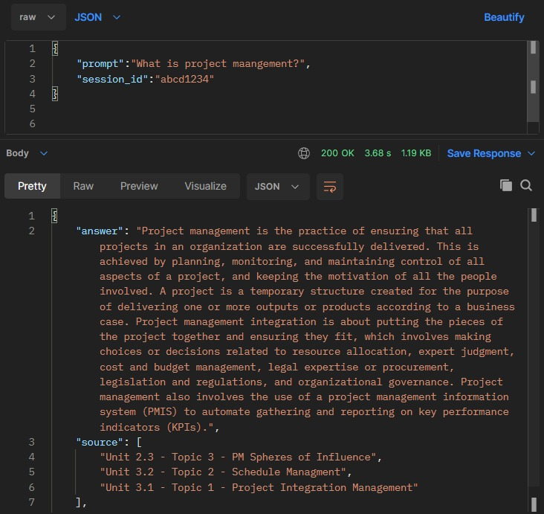
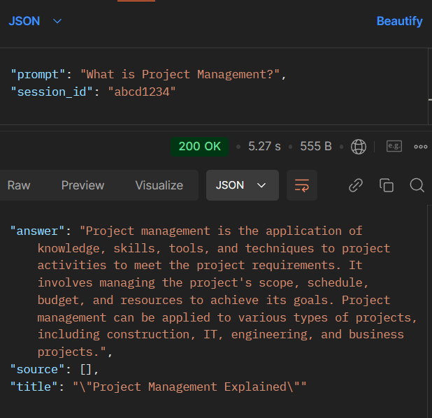
Demo
Data Retrieval from the Context
Current Response
Previous Response

Slide 6
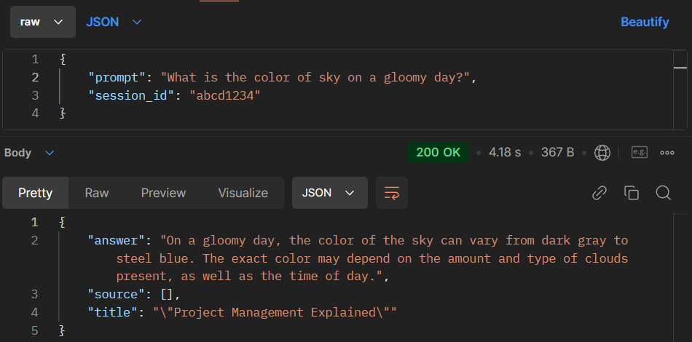
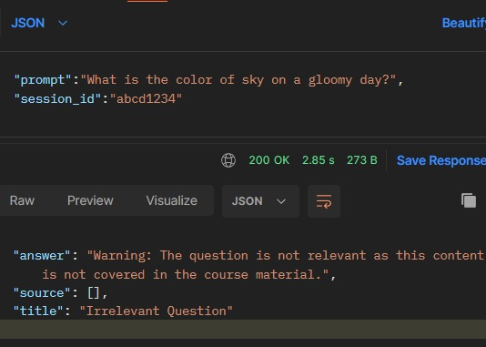
Demo
Out of the resource question
Previous Response
Current Response

Slide 7

Demo
Batch file

Slide 8
Blockers
Based on the choice of model, there was a great difference in the output
Unexpected responses generated by the model
Setting up the environment on the Laptop
Network issues, library issues

Slide 9
Next Plan
Migrating to React
Add voice input functionality for end users
Planning for the next term
Notes:
(if time is limited, it may end up as research, but plan to finish at least standalone version)

Slide 10
Q & A

